Slide 1

CUSTOMER PREDICTION
FOR PURPOSES OF FORAGE VIRTUAL WORK EXPERIENCE PROGRAM
MADE BY:
IRA SAFONIK
22.04.2024

Slide 2
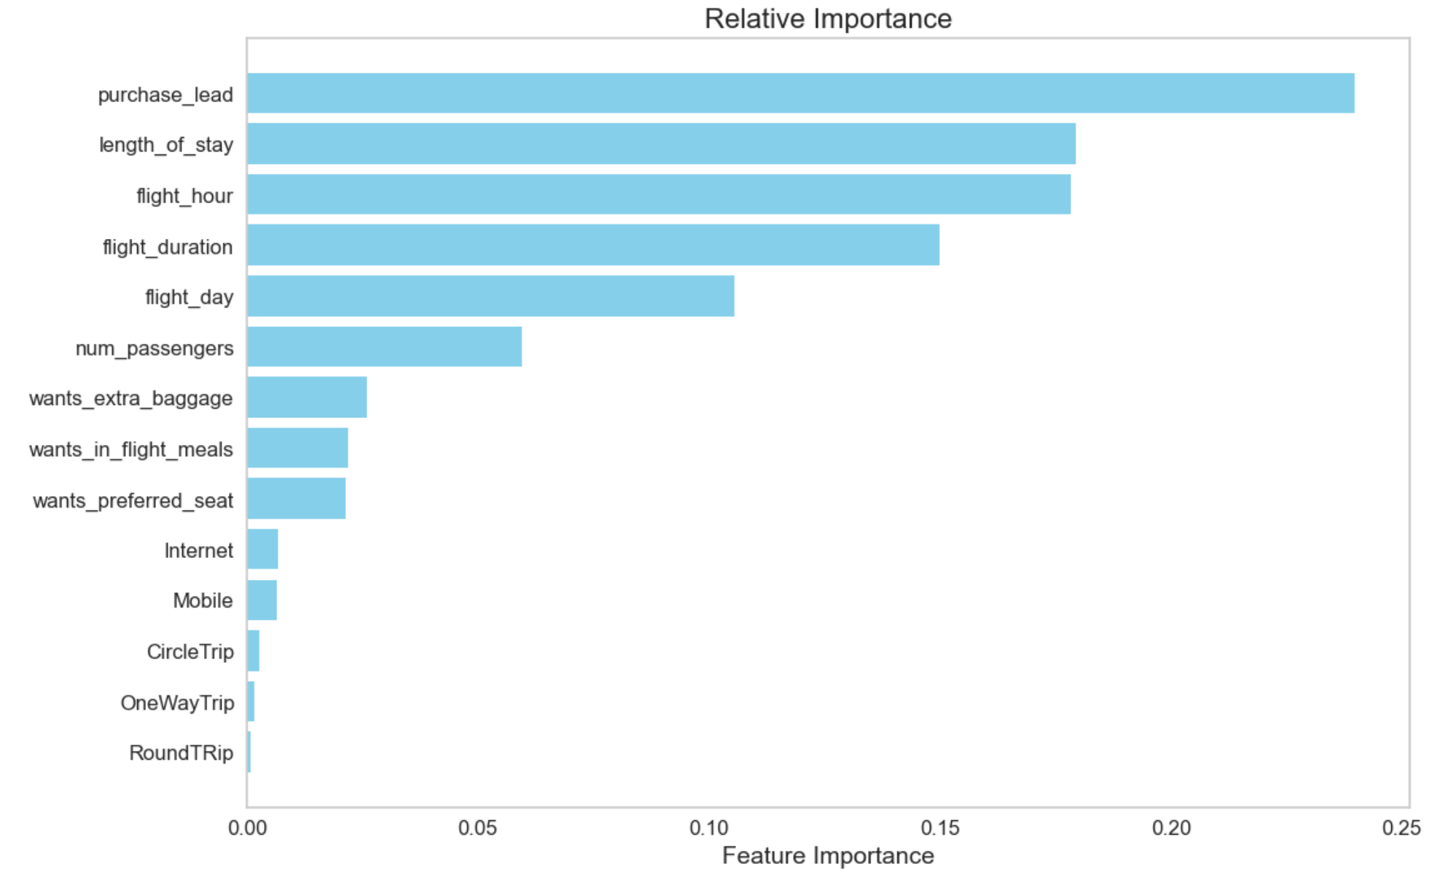
INSIGHTS FROM CUSTOMER PREDICTION
Evaluation:
The primary predictor in the model was the purchase_lead variable, representing the time between purchase and departure.
Flight-related information such as flight time and duration also exhibited significance in predicting outcomes.
Conversely, the booking origin of the customer appeared to be less influential.
The model achieved an accuracy of approximately 70% (Precision) and a recall of only 0.3%, indicating the need for further refinement.
To enhance model performance, I recommend incorporating additional customer-centric features.
Precision
70%
Recall
0.3%

